Slide 1

Micro Kernels and RTOS
Topics:
What is a Kernel
Comparison - Monolithic and Micro kernel
Micro kernel and RTOS
QNX Neutrino RTOS
Expectation from RTOS
How to choose a commercial RTOS

Slide 2
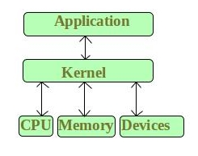
What is a Kernel?
A kernel is a central component of an operating system.
It acts as an interface between the user applications and the hardware.
The sole aim of the kernel is to manage the communication between the software (user level applications) and the hardware (CPU, disk memory etc).
The main tasks of the kernel are :
Process management, Device management, Memory management, Interrupt handling, I/O communication, File system...etc..

Slide 3
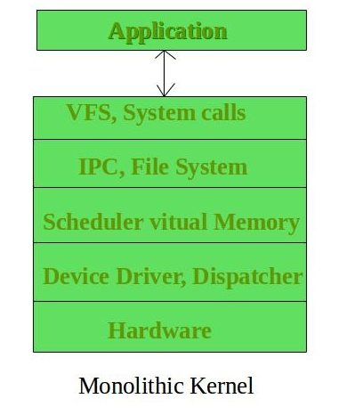
Types
Kernels may be classified mainly in two categories
1. Monolithic
In this type of kernel architecture, all the basic system services like process and memory management, interrupt handling etc were packaged into a single module in kernel space.
This type of architecture led to some serious drawbacks like
Size of kernel, which was huge.
Poor maintainability, which means bug fixing or addition of new features resulted in recompilation of the whole kernel which could consume hours

Slide 4
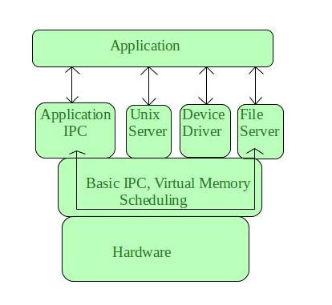
2. Micro Kernel
This architecture allows some basic services like device driver management, protocol stack, file system etc to run in user space.
This reduces the kernel code size and also increases the security and stability of OS as we have the bare minimum code running in kernel.
So, if suppose a basic service like network service crashes due to buffer overflow, then only the networking service's memory would be corrupted, leaving the rest of the system still functional.

Slide 5
Main functionality of micro kernel
The bare minimum that micro Kernel architecture recommends in kernel space is:
Managing memory protection
Process scheduling
Inter Process communication (IPC)
Apart from the above, all other basic services can be made part of user space and can be run in the form of servers.

Slide 6
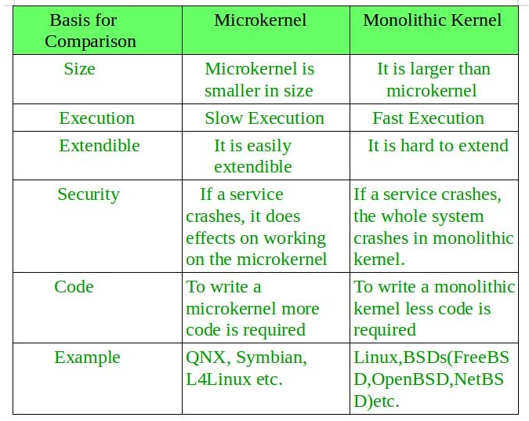
Comparison between monolithic and micro kernel

Slide 7
What is a monolithic RTOS?
Monolithic means huge. By definition, a monolithic kernel runs all operating system components in the kernel space.
For instance, a monolithic RTOS includes device drivers, file management, networking, and graphics stack as part of the kernel space. Applications, however, run in the user space.
Although running user applications as memory-protected processes protects a monolithic kernel from error in the user code, a single programming error in a file system, protocol stack or driver can crash the system.
In addition, any change to a driver or system file requires OS modification and recompiling.

Slide 8
What is a microkernel RTOS?
A microkernel RTOS is structured with a tiny kernel that provides minimal services.
The microkernel works with a team of optional cooperating processes that run outside kernel space (in the user space), which provides higher-level OS functionality.
A microkernel RTOS has a key feature - modularity and hence the small size
In a microkernel, only the core RTOS kernel is granted access to the entire system, which improves reliability and security.
The microkernel protects and allocates memory for other processes and provides task switching. All other components, including drivers and system-level components, are each contained within their own isolated process space.
Isolation prevents errors in a component from affecting other parts of the system – the only thing that a component can crash is itself.
Such crashes can be easily detected, and the faulty component can be restarted – while the system is still running – quick restart has no effect on performance

Slide 9
QNX Neutrino RTOS is a commercial microkernel RTOS
Since 1980, thousands of companies have deployed and trusted QNX real-time technology to ensure the best combination of performance, security and reliability in the world’s most mission-critical systems.
At the core of this offering is QNX Neutrino Realtime Operating System (RTOS), a full-featured and robust RTOS designed to enable the next-generation of products for automotive, medical, transportation, military and industrial embedded systems.
The microkernel design and modular architecture enable BlackBerry® QNX® customers to create highly optimized and reliable systems with low total cost of ownership.
With the QNX Neutrino RTOS, embedded systems designers can create compelling, safe, and secure devices built on a highly reliable RTOS serving as the foundation that helps guard against system malfunctions, malware and security breaches

Slide 10
What to expect in a RTOS
An RTOS delivers functionality that helps embedded systems developers deliver safe, secure and reliable products.
The key RTOS functionality to look for or to consider building into your own RTOS are:
spatial and temporal separation,
adaptive partitioning,
preemptive priority-based scheduling,
system determinism and
responsiveness

Slide 11
Spatial separation
Spatial or hardware separation, also called spatial isolation, provides each process with its own private address space.
Embedded systems require the isolation of software components to ensure freedom from interference in hardware (spatial) and time (temporal).
An MMU allows an RTOS to use a process model – each task (process) is allocated its own virtual address space – for much greater reliability.
In comparison, without an MMU, code, data and the kernel itself would compete for and share the same memory space – a less reliable approach.

Slide 12
Temporal separation
Temporal separation, also called temporal isolation, allows each process to run without depending on the timing of another unrelated system sharing the same hardware or software resources.
RTOS scheduling provides temporal separation by ensuring process threads run when they are supposed to, and there are always enough CPU computing cycles to go around.
By partitioning resources, scheduling algorithms deliver temporal separation between tasks with different levels of criticality – ensuring the higher priority task gets the resources it needs.
Tasks generally include both periodic (regular) tasks and aperiodic (irregular) tasks. The most common ways to provide temporal separation are static and adaptive partitioning.

Slide 13
Interprocess communication (IPC)
Interprocess communication adds an additional layer of isolation between address spaces.
Developers need to pass data between processes or tasks.
In the QNX RTOS, interprocess communication maps POSIX calls to messages, in addition to the hardware separation afforded by the MMU.
A message-based approach to interprocess communication provides a high level of architectural decoupling as required by safety standards such as ISO 26262.
Although message passing is the primary form of interprocess communication in the QNX OS, other forms of IPC are also available.
Message passing is part of the POSIX standard and all BlackBerry QNX solutions are POSIX-compliant.

Slide 14
Priority-based preemptive scheduling
Priority-based preemptive scheduling allows high-priority threads to meet their deadlines consistently, even when there is a lot of competition for resources.
With priority-based preemptive scheduling, a high-priority thread can, within a small and bounded time interval, take over the CPU from any lower-priority thread.
The high-priority thread can run uninterrupted until it has finished – unless it is preempted by an even higher-priority thread.

Slide 15
System determinism
Deterministic real-time scheduling ensures that the most urgent software runs when it needs to.
Preemptive priority-based multitasking is deterministic.
The scheduler uses priorities to determine which task should run next.
Unexpected systems loads, including third-party code, will not adversely affect safe operation.
A deterministic RTOS ensures that priority threads get the time they need, when they need it, by preempting a lower-priority task.
For example, in a car crash, the airbags must deploy immediately, not wait for another task to finish.

Slide 16
Responsiveness
Embedded systems with hard real-time constraints require responsiveness.
Real-time applications depend on the OS to handle multiple events and to ensure that the system reacts within an expected timeframe to those events.
In other words, the system’s response time must be predictable.
The QNX RTOS is ideal for mission-critical systems that require responsiveness and absolute reliability

Slide 17
How to choose a commercial RTOS
A commercial RTOS can save engineering time and effort and improve the reliability and performance of your embedded systems.
Aspects that include:
Security and safety
Graphics and human machine interface
Maintenance and updates
Hardware support
Licensing
Vendor reputation and quality of support

Slide 18
Contemporary RTOS
PSOS
VRTX
VxWorks
QNX
RT Linux
Lynx
Windows CE

Slide 19
Summary
What is a Kernel
Comparison - Monolithic and Micro kernel
Micro kernel and RTOS
QNX Neutrino RTOS
Expectation from RTOS
How to choose a commercial RTOS

